Slide 1

tiktok is a word i’m allowed to say now
or, what being a tiktok influencer taught me about analysis

Slide 2
my plan
(but please interrupt me)
01
@zevulous
02
parallels
03
a plea

Slide 3
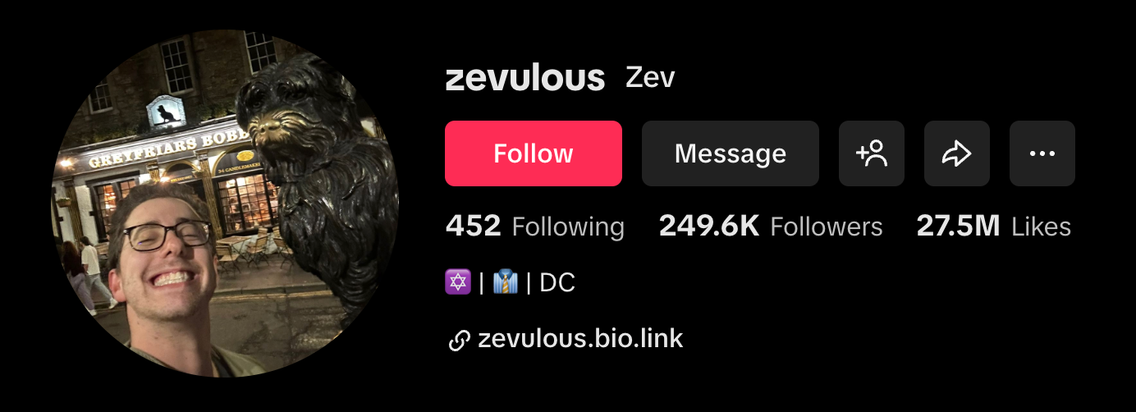
@zevulous
Max 256.6k followers
27.5M likes across all videos
Follower Age
18-24: 30.9%
25-34: 37.8%
35-44: 18.3%
Follower Gender
Male: 36%
Female: 64%
Other: <1%
Follower Location
United States: 57.6%
Other: 28.5%
UK: 3.8%
Canada: 3.2%
Australia: 1.8%

Slide 4
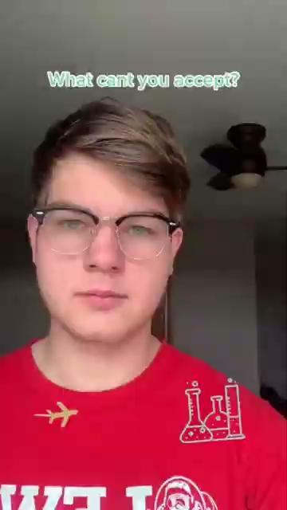
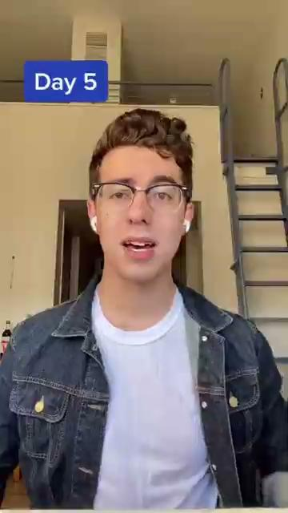
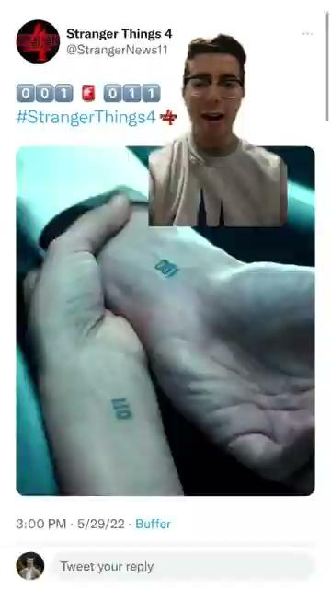
@zevulous
01 - First Posting
02 - Content Moderation
03 - Judaism + Others
3m views, 470.3k likes
Mostly about spreading awareness of the book, and then there’s a math fact in there
8.2m views, 1.3m likes
Started doing more with Judaism and comedy
271.7k views, 127.8k likes
In DC for January 6th and realized I could help, sparked an over 100+ day effort for content moderation

Slide 5
my plan
(but please interrupt me)
01
@zevulous
02
parallels
03
a plea

Slide 6
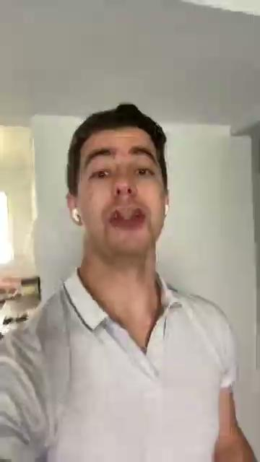
parallels
5.2 million views
The Hook
Precision + Concision
1.1 million likes
Bias
Launched a sponsorship
Sources

Slide 7
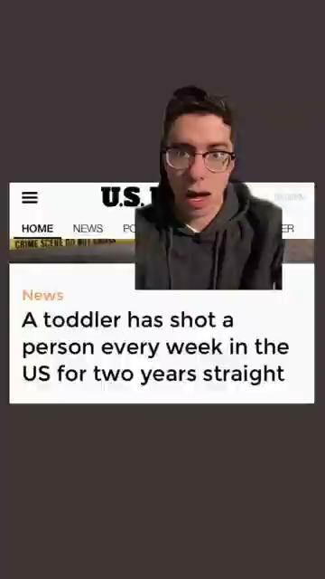
parallels
3 million views
The Hook
Precision + Concision
Bias
491.5k likes
Sources

Slide 8
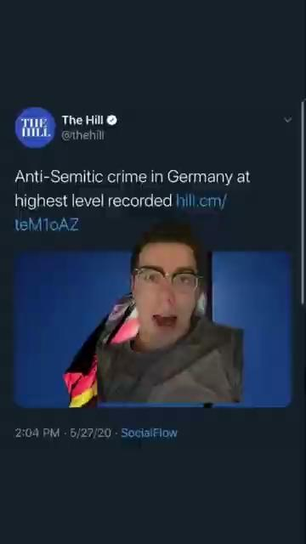
parallels
1.3 million views
The Hook
Precision + Concision
165.9k likes
Bias
Sources

Slide 9
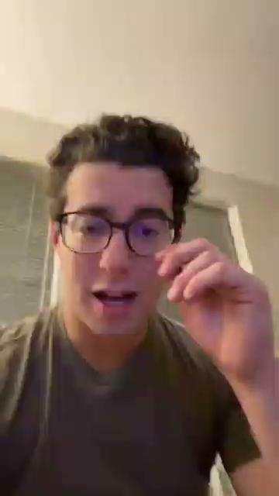
parallels
428.5k views
The Hook
Precision + Concision
Bias
53.6k likes
Sources

Slide 10
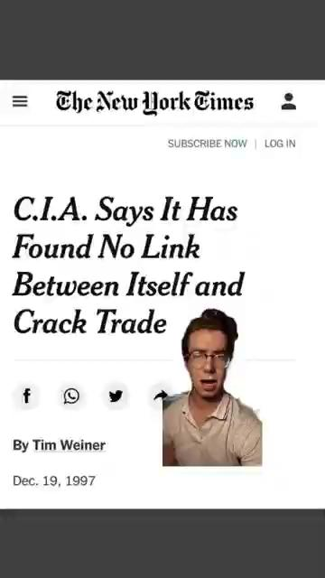
parallels
471.3k views
The Hook
Precision + Concision
Bias
92.7k likes
Sources

Slide 11
my plan
(but please interrupt me)
01
@zevulous
02
parallels
03
a plea

Slide 12
What goes into a video
What will get views?
What is trending right now that I can apply to my niche/content?
Am I known for this thing and need to keep up the branding?
What will get me a sponsorship?
(related: Do I have a contractual obligation to make a video on this?)

Slide 13
What doesn’t go into a video
Nuance
Fact checking
Coordination
The “average” opinion

Slide 14
Questions?

